Slide 1
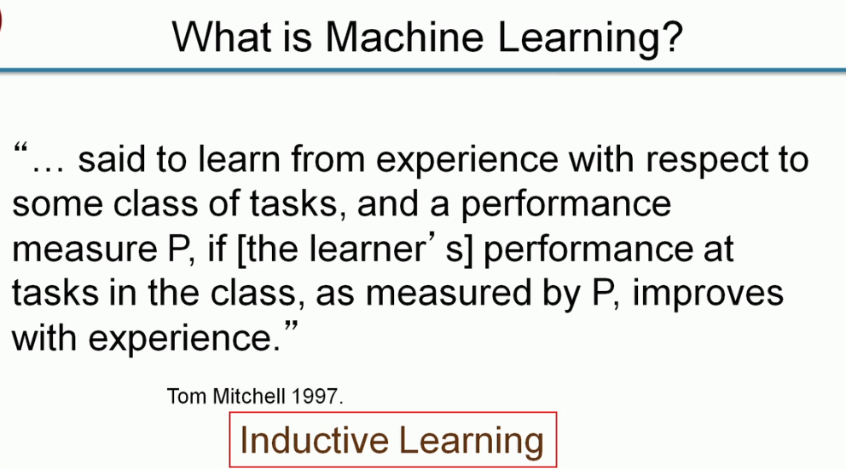

Slide 2
DATA
Terms of Interest
Class of tasks | Performance Measures | Experience
Writing an Exam | Marks Scored | More Examinations
Diagnosing a Particular Illness | Drug effects, Quantity etc | More patients with similar illness

Slide 3
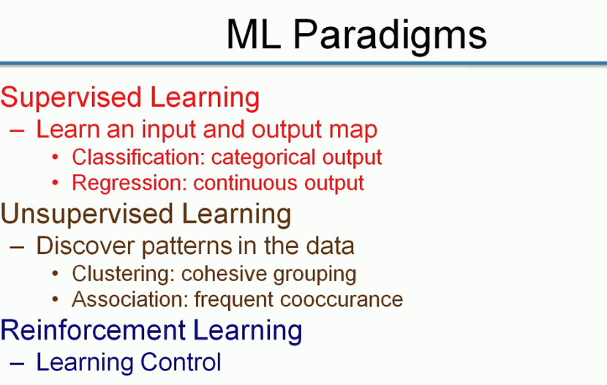
INDUCTIVE LEARNING Vs QUANTITATIVE LEARNING
Input: Patient with certain symptoms Output: To predict the disease
Yes/No ,True/False etc.
How long( Time, Height, functions etc.)
Type of purchases
Customer visiting to my shop
Customer A comes then B also comes

Slide 4
INDUCTIVE LEARNING Vs QUNATITATIVE LEARNING
PERFORMANCE MEASURES
Classification Error
Cost Function
Purity
Support Confidence and Lift
Cost

Slide 5
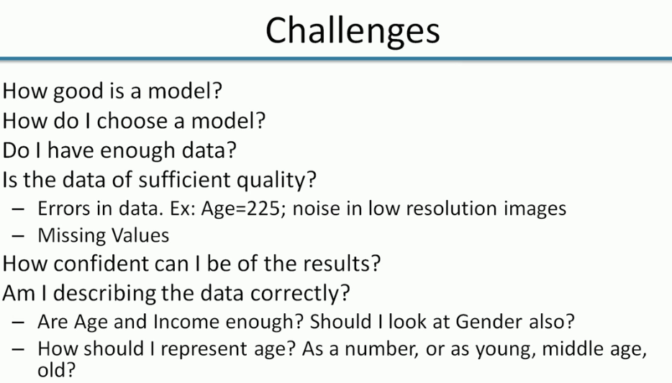
Parameters for performance measures
Domain Specific

Slide 6
Jai Sairam

